Slide 1
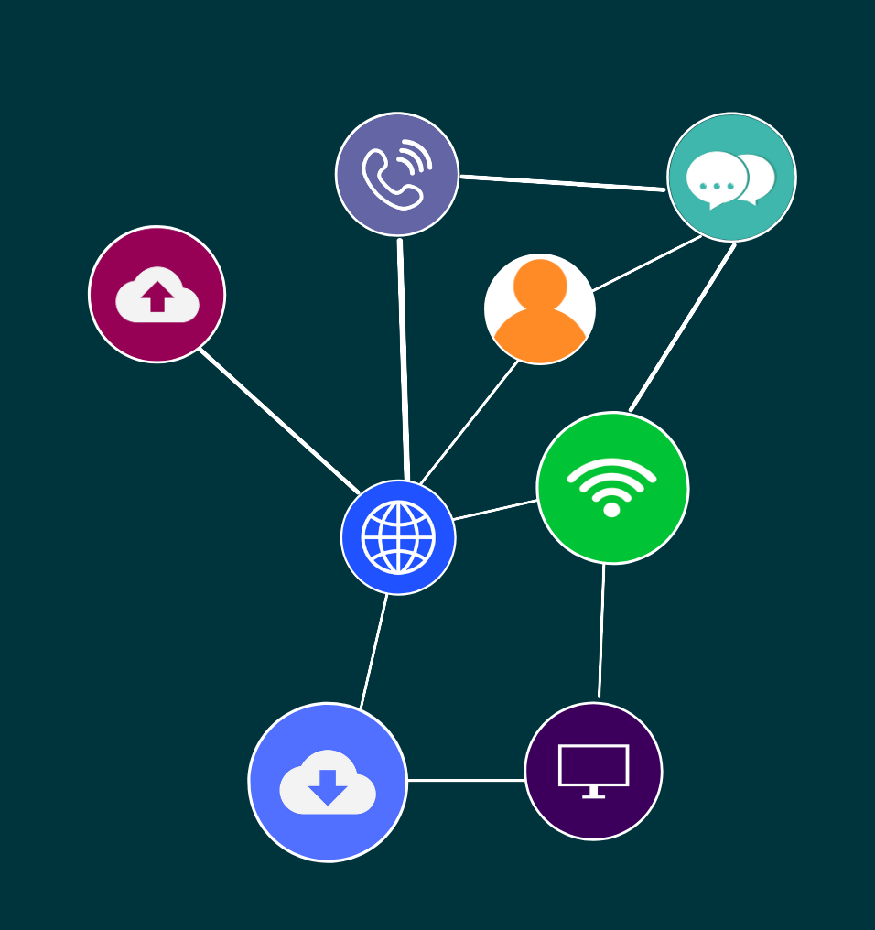


ICTPMG613
Manage ICT project planning

Slide 2
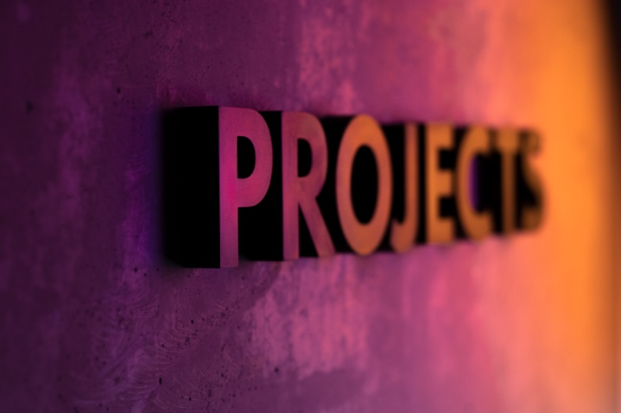
2
Topic 1: Planning and controlling a project
© 2021 RTO Works

Slide 3
3
ICT PROJECTS
To plan and manage an Information and Communications Technology (ICT) project, whether it is for a small, medium or large organisation, you need to apply project management skills.
Topic 1: Planning and controlling a project
Topic 1: Insert topic title
© 2021 RTO Works

Slide 4
4
THE PROJECT LIFECYCLE
Initiation
Planning
Execution
Closure
Topic 1: Planning and controlling a project
Topic 1: Insert topic title
© 2021 RTO Works

Slide 5
5
WHY PLAN A PROJECT?
Project planning is an essential stage of a project’s lifecycle. It establishes the scope, schedules, resources, budgets and control process used to support the management of a project.
Topic 1: Planning and controlling a project
Topic 1: Insert topic title
© 2021 RTO Works

Slide 6

6
ACTIVITY: DOWNLOADS
Project Management Docs is a great website that provides a range of free templates.
Topic 1: Planning and controlling a project
© 2021 RTO Works

Slide 7
7
MODELS OF PROJECT MANAGEMENT
In ICT project management there are a number of different project management methods and approaches. That will also have an effect on the way a project is controlled and managed.
Topic 1: Planning and controlling a project
Topic 1: Insert topic title
© 2021 RTO Works

Slide 8
8
ACTIVITY: WATCH
Watch this engaging video to learn more about each stage of the SDLC.
Software Development Lifecycle in 9 minutes!
Video: https://www.youtube.com/watch?v=i-QyW8D3ei (09:13)
The trainer/assessor will facilitate a discussion about the outcomes from the video.
Topic 1: Planning and controlling a project
© 2021 RTO Works

Slide 9
9
THE SOFTWARE DEVELOPMENT LIFECYCLE
Planning
Analysing
Designing
Building
Testing
Deployment
Maintenance
Topic 1: Planning and controlling a project
Topic 1: Insert topic title
© 2021 RTO Works

Slide 10
10
ACTIVITY: READ
What methodology should I choose? Read the following article, which outlines different models and where they are best suited:
https://blog.teamwork.com/project-management-methodologies/
Take any notes to summarise what you have read and keep for future reference
Topic 1: Planning and controlling a project
© 2021 RTO Works

Slide 11
11
ACTIVITY: RESEARCH AND DISCUSS
Work in pairs, researching the following:
The 12 Agile principles.
Green IT/Green PM.
The 7 principles of PRINCE2.
Iterative and Spiral models of development.
Topic 1: Planning and controlling a project
© 2021 RTO Works

Slide 12
12
DOCUMENTATION
Once a project management plan has been written, it will need approval.
Approval of the project plan will vary dependent upon the size and nature of the project, the approval procedure and/or organisational policies and procedures.
Topic 1: Planning and controlling a project
Topic 1: Insert topic title
© 2021 RTO Works

Slide 13
13
TAILORING
Just with most things in life, there is ‘no one size fits all’ when it comes to projects. Every project is unique!
Tailoring may include adding, removing or changing certain processes to ensure flexibility.
Topic 1: Planning and controlling a project
Topic 1: Insert topic title
© 2021 RTO Works

Slide 14
14
ACTIVITY: READ AND DISCUSS
Read the following article about tailoring:
https://www.projectmanagement.com/blog-post/21168/The-Art-of-Tailoring--Making-Your-Project-Management-Methodology-Fit
Your trainer will facilitate a discussion in which you will discuss what processes can potentially be tailored and the benefits of tailoring.
Topic 1: Planning and controlling a project
© 2021 RTO Works

Slide 15
15
PROJECT COMMUNICATION
A project manager needs to have excellent communication skills. They will be communicating both in writing and verbally all the time: to the project sponsor, to key stakeholders, to their project team, to the board/committee and to suppliers.
Topic 1: Planning and controlling a project
Topic 1: Insert topic title
© 2021 RTO Works

Slide 16

16
Topic 2: Scheduling a project
© 2021 RTO Works

Slide 17
17
The project schedule is a key document in project planning. It must include the tasks/activities, milestones and deliverables required to lead the project to success.
Topic 2: Scheduling a project
Topic 1: Insert topic title
© 2021 RTO Works

Slide 18
18
ACTIVITY: WATCH
In this video Jennifer will give you an overview of project scheduling and what needs to be considered.
What is Project Scheduling?
Video: https://www.youtube.com/watch?v=WNWSQOynrl0 (03:27)
Topic 2: Scheduling a project
© 2021 RTO Works

Slide 19
19
ACTIVITY: READ
Look through this page to see the range of different project scheduling tools that can be used. You may also like to scroll further down to read the advice about project schedule development:
https://www.smartsheet.com/content/project-schedule-templates
Take any notes to summarise what you have read and keep for future reference.
Topic 2: Scheduling a project
© 2021 RTO Works

Slide 20
20
THE WORK BREAKDOWN STRUCTURE (WBS)
The Work Breakdown Structure is a breakdown of all the activities and tasks that make up a project. It is a tool used to break down work into manageable chunks.
Topic 2: Scheduling a project
Topic 1: Insert topic title
© 2021 RTO Works

Slide 21
21
ACTIVITY: READ
An example of a WBS for IT Projects:
https://project-management.com/work-breakdown-structure-for-it-projects-wbs/
Take any notes to summarise what you have read and keep for future reference.
Topic 2: Scheduling a project
© 2021 RTO Works

Slide 22
22
THE WORK BREAKDOWN STRUCTURE (WBS)
A WBS can also be represented in table format. WBS use codes to identify each unique activity along with the task and phase to which it belongs.
Topic 2: Scheduling a project
Topic 1: Insert topic title
© 2021 RTO Works

Slide 23
23
ACTIVITY: READ AND DISCUSS
Learn about the difference between a work package and an activity.
https://www.pmlearningsolutions.com/blog/work-package-versus-activity-pmp-concept-14
Think about the definitions of work package and activities provided above.
Choose an ICT project and think of one work package that would be relevant, and the activities within that work package.
Topic 2: Scheduling a project
© 2021 RTO Works

Slide 24
24
ACTIVITY: WATCH
Watch this video that explains how to estimate project effort and duration.
How to Estimate Tasks & Dependencies.
Video: https://www.youtube.com/watch?v=IVtLYDHNbEI (05:06)
Topic 2: Scheduling a project
© 2021 RTO Works

Slide 25
25
SEQUENCING PROJECT TASKS
There are a number of methods to sequence project tasks. This can include:
Network diagrams
Gantt Charts
DFD
Flow charts
Project management software tools.
Topic 2: Scheduling a project
Topic 1: Insert topic title
© 2021 RTO Works

Slide 26
26
ACTIVITY: PRACTICAL
Using spreadsheet software, use the provided information to construct a Gantt chart which shows timings for deliverables.
Topic 2: Scheduling a project
© 2021 RTO Works

Slide 27
27
PROJECT SCHEDULE CONTROLS
A project manager needs to be able to use their schedule to identify how the project activities are tracking.
To be able to do this efficiently, the project manager will need to be able to compare actual/current project performance with scheduled performance.
Topic 2: Scheduling a project
Topic 1: Insert topic title
© 2021 RTO Works

Slide 28
28
ACTIVITY: READ
The following example of how to effectively manage complex project schedules uses a case study which examines planning and control processes:
https://www.pmi.org/learning/library/effectively-manage-complex-project-schedules-8229
Read through the following example on how to create a project management schedule:
https://www.projectmanager.com/blog/create-project-management-schedule
What are dependencies between tasks and why do you have to identify these?
Topic 2: Scheduling a project
© 2021 RTO Works

Slide 29

29
Topic 3: Project budgets
© 2021 RTO Works

Slide 30
30
A project budget is the document that provides the project manager with the estimated costs of the project. Aside from scheduling, developing and sticking to the project can be quite stressful for a project manager due to the pressure from the board/committee.
Topic 3: Project budgets
Topic 1: Insert topic title
© 2021 RTO Works

Slide 31
31
ACTIVITY: READ
Read the following articles to learn more about the stressful process of project budgeting!
https://corporatefinanceinstitute.com/resources/knowledge/finance/project-budget-overview/
https://www.clarizen.com/project-budgets-tips-estimating-cost-tracking/
Take any notes to summarise what you have read and keep for future reference.
Topic 3: Project budgets
© 2021 RTO Works

Slide 32
32
THE PROJECT BUDGETING PROCESS
Identify scope elements that must be costed.
Conduct cost management planning.
Estimate work package costs.
Combine cost estimates and project schedule.
Produce the budget in accordance with company cost management procedures.
Adjust budget for contingencies.
Topic 3: Project budgets
Topic 1: Insert topic title
© 2021 RTO Works

Slide 33
33
THE PROJECT BUDGETING PROCESS
Apply adjustments, allowing for dependencies and constraints within the project scope.
Review the budget to ensure that all WBS packages have been fully costed.
Topic 3: Project budgets
Topic 1: Insert topic title
© 2021 RTO Works

Slide 34
34
PROJECT COST ESTIMATION TECHNIQUES/METHODS
Analogous estimating
Parametric modelling
Bottom-up estimating
Topic 3: Project budgets
Topic 1: Insert topic title
© 2021 RTO Works

Slide 35
35
COST–BENEFIT ANALYSIS
The purpose of conducting a cost–benefit analysis is:
to determine if an investment or decision is sound; this involves verifying whether its benefits outweigh its costs, and if so, by how much
as a basis for comparing projects; this involves comparing the expected cost of each option against its expected benefits.
Topic 3: Project budgets
Topic 1: Insert topic title
© 2021 RTO Works

Slide 36
36
KEY PERFORMANCE INDICATORS
Key performance indicators assist managers to analyse the current financial position of a company and in considering trends and establishing patterns. These patterns can then identify the strengths and weakness of the company.
Topic 3: Project budgets
Topic 1: Insert topic title
© 2021 RTO Works

Slide 37
37
CASH FLOW
An important part of developing the budget will include determining cash flow.
It doesn’t matter how good the budget is, if you don’t where and how money is being moved during the project’s lifecycle, you could potentially end up with no money.
Topic 3: Project budgets
Topic 1: Insert topic title
© 2021 RTO Works

Slide 38
38
ACTIVITY: READ AND DISCUSS
Read the following article about keeping large IT projects on budget:
https://www.mckinsey.com/business-functions/mckinsey-digital/our-insights/delivering-large-scale-it-projects-on-time-on-budget-and-on-value
Take any notes to summarise what you have read and keep for future reference.
Topic 3: Project budgets
© 2021 RTO Works

Slide 39
39
ACTIVITY: WATCH
How To Estimate Your Project.
Video: https://www.youtube.com/watch?v=rN0FrDpQNUk&t=34s (03:35)
What to do when your project is over budget?
Video: https://www.youtube.com/watch?v=xYR7dkQPHKY (06:02)
Topic 3: Project budgets
© 2021 RTO Works

Slide 40
40
COST CONTROL
Just like with scheduling, it is common in project management for unforeseen costs to occur. However, implementing cost controls can help the project manager identify the potential risks for budget blow out and how to address them.
Topic 3: Project budgets
Topic 1: Insert topic title
© 2021 RTO Works

Slide 41
41
ACTIVITY: WATCH
Watch the video below to learn more about cost control.
Project Cost Management Tips: Keeping your project budget under control.
Video: https://www.youtube.com/watch?v=oXhgwn-girI (06:16)
Topic 3: Project budgets
© 2021 RTO Works

Slide 42
42
ACTIVITY: READ
Read the articles below for examples where IT project budgets ended up out of control:
https://www.brisbanetimes.com.au/politics/queensland/delayed-queensland-government-project-more-than-doubles-in-cost-20181011-p5093x.html
https://www.projectmanager.com/blog/failed-projects
As we finish up, review the following project management statistics, particularly those related to budgets.
Not everyone gets everything right all the time!
https://learn.g2.com/project-management-statistics
Topic 3: Project budgets
© 2021 RTO Works

